Slide 1
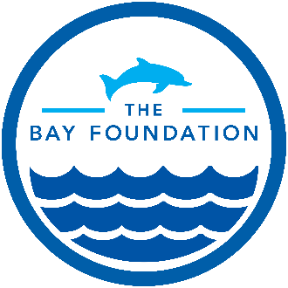
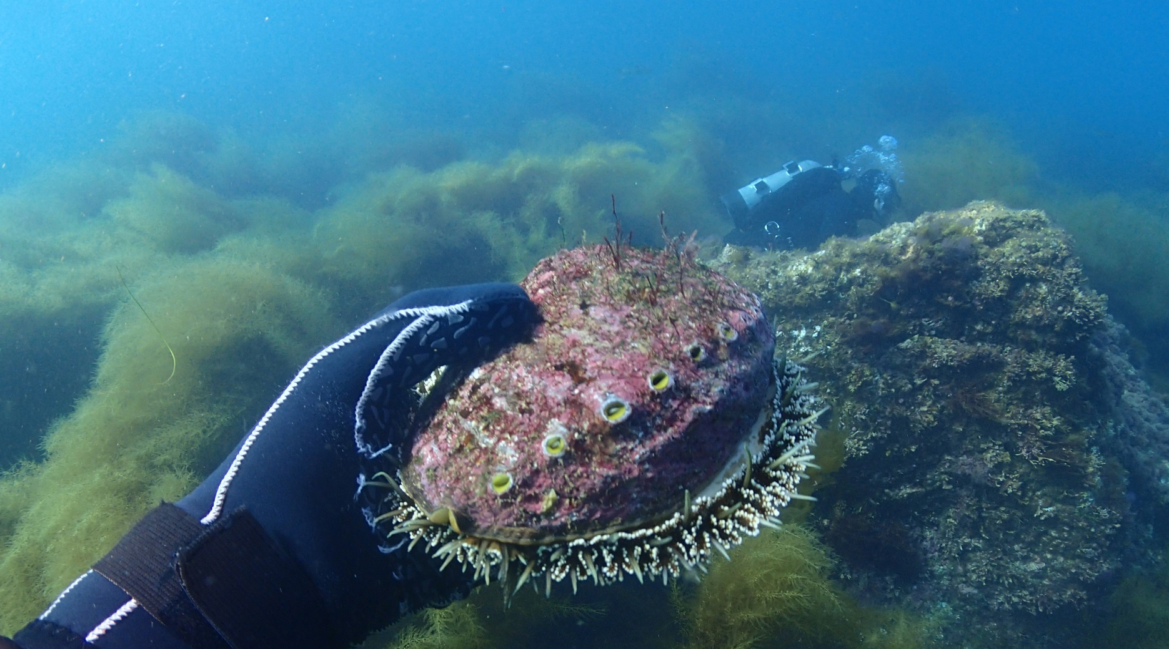
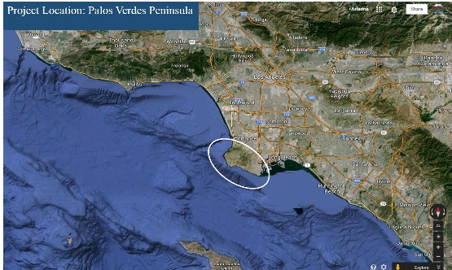
Southern California Green Abalone Restoration Project
A part of the U.S. EPA’s Santa Monica Bay National Estuary Program
Native Reef Restoration
Text here
map
Abalone are functional components of healthy kelp forest ecosystems, providing competition for space and food with other grazers such as sea urchins. Abalone also once supported a thriving commercial and recreational fishery in Southern California. However, due to overharvesting and disease, 4 of the 7 abalone species native to Southern California are now federally listed under the Endangered Species Act. Green Abalone (Haliotis fulgens), a federal species of concern, was once plentiful along the Palos Verdes Peninsula and most of Southern California.
The Southern California Green Abalone Restoration Project is exploring methods and techniques for restoring abalone populations in Southern California. This includes spawning abalone in captivity and in the wild, rearing them to different life stages, and then outplanting them onto rocky reef habitat in Southern California. Successful methods will be transferred to restoration efforts of other abalone species, including endangered black and white abalone.
Project Location
Palos Verdes Peninsula,
Southern California, U.S.A.
Fast Facts
Abalone contribute to the health of California’s kelp forest ecosystems
Outplanting abalone can increase local populations and boost natural reproduction

Slide 2
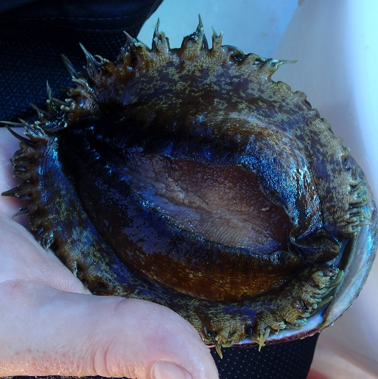
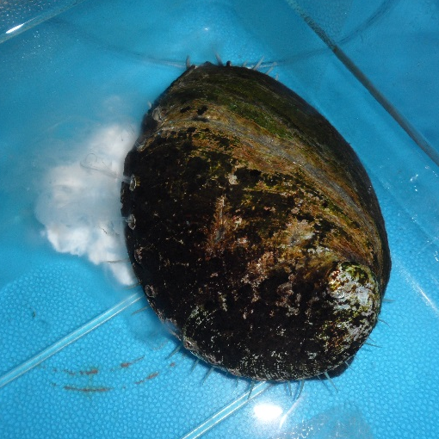
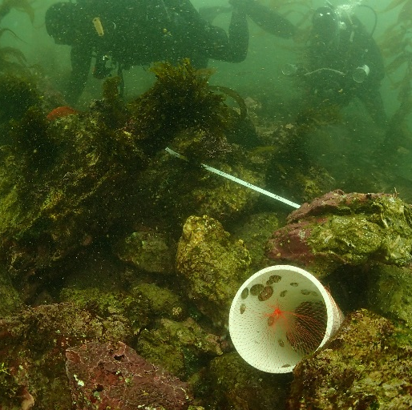
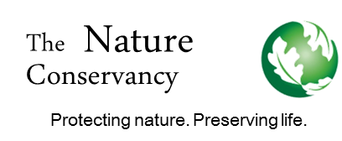

Restoring Abalone: A Hands-On Approach
Project Partners
The Nature Conservancy
NOAA
CA Department of Fish and Wildlife
The SEA Lab
Vantuna Research Group
California Science Center
State Coastal Conservancy
Cabrillo Marine Aquarium
Genetics and Disease Testing
Before beginning breeding or outplanting experiments, abalone throughout Southern California were tested to see if they were 1) genetically related and 2) if they had been exposed to Withering Foot Syndrome (WS), a pervasive bacterial disease affecting abalone in the region. It was discovered that sampled abalone were genetically related, and individuals from separate locales could therefore be moved and mated together without compromising the genetic integrity of the population. Abalone from all locales were found to have been exposed to WS, so breeding activities would not pose a risk for increased transmission or introduction.
picture
Working Together
Captive and Wild Spawning Trials
Project partners are experimenting with different methods of spawning abalone to produce larvae and juveniles for outplanting. In a new technique called “deck spawning”, adult abalone are collected from the wild, induced to spawn on the deck of a boat, and returned to the ocean after spawning. If perfected, this method could reduce the need to keep adult abalone in captivity as broodstock, which would save considerable time and resources.
The Bay Foundation’s Green
Abalone Restoration Project is
linked to our larger Southern
California Kelp Forest
Restoration efforts. For more
information visit our website at:
www.santamonicabay.org
Outplanting into the Wild
A major goal of the project is to outplant abalone onto rocky reef habitat in areas of Southern California where abalone were once abundant. Project partners have outplanted 863 juvenile abalone off the coast of Palos Verdes, CA to test outplanting methods. Divers are continuously monitoring the site to track the juvenile abalone survival and dispersal.
The National Partnership between the NOAA Community-based
Restoration Program and The Nature Conservancy implements
innovative conservation activities that benefit marine, estuarine and
riparian habitats across the United States. The NOAA Restoration
Center has worked with community organizations to support locally-
driven projects that provide strong on-the-ground habitat restoration
components that offer educational and social benefits for people and
their communities, as well as long-term ecological benefits.

